Slide 1
Evaluation and Course Introduction On Simulation and Modeling
Department of Computer Science and Engineering

Slide 2
Evaluation
Internal Evaluation-50
Theory -30
UT -6
Assessment -12
Assignment-5
Class performance-4
Attendance-3
Practical -20
Lab report-4
Lab attendance-3
Lab exam/Lab project-10
Lab performance-3

Slide 3
Simulation and Modeling (3-1-3)
Course Introduction
In general, this course will introduce the basic concept of modelling and simulation that are extensively used by engineers to innovate new products, evaluate designs and simulate the possible impacts of alternative approaches.
Prerequisites
Basic knowledge of numerical mathematics, probability and statistics, and basics of programming (C or C++ or C# or Java)
Course Objective
To introduce the details of modeling and simulation technologies to the students.
To provide the knowledge of discrete and continuous system, generation of random variables, analysis of simulation output and simulation languages.

Slide 4
Simulation and Modeling (3-1-3)
Major Assignments: Descriptions
Upon the completion of each chapters assignment related to that chapter will be provided to the students with submission date.
Paper related to Modelling and Simulation Basics will be provided for critical writing
Selected topics related to computer simulation will to assigned to the group (three members each as formed by instructor) for oral presentation
Class Participation
Expected to make a summary of given journals.
Expected to solve all the assignments provided in class.
Expected to make critical comments on given journals.
Expected to make an oral presentation on selected topics given by instructor.

Slide 5
Syllabus
Sim n Mod PPT\SimulationnModeling Review final.docx

Slide 6
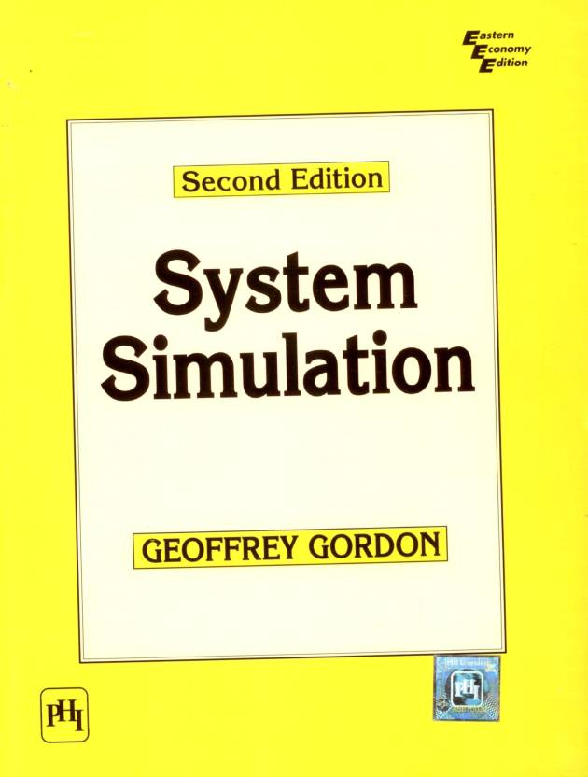
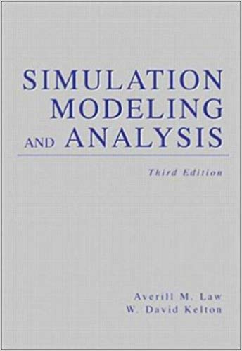
Text Books and References
Text Books:
1. G. Gorden, System Simulation, Prentice Hall of India.
2. A.M. Law and WD. Kelton. Simulation Modeling and Analysi.r, McGraw Hill. 1991
References:
1. JA. Spriest and G.C. Vansteenkiste, Computer—Aided Modeling and Simulation, Academic Press.
2. AM Law and R.F. Parry, Simulation: A Problem-solving approach, Addison, Wesley Publishing Company.
3. Narsingh Deo, “System Simulation with Digital Computer”

Slide 7
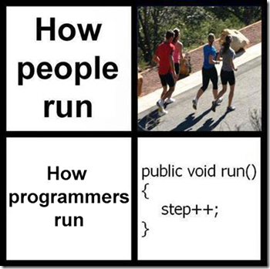

Slide 8
Chapter 1 Introduction to Modeling and Simulation

Slide 9
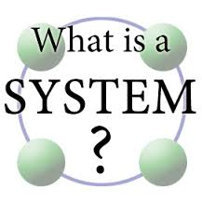

Slide 10
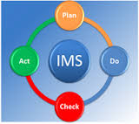



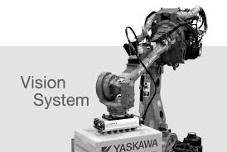
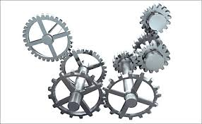
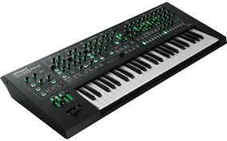
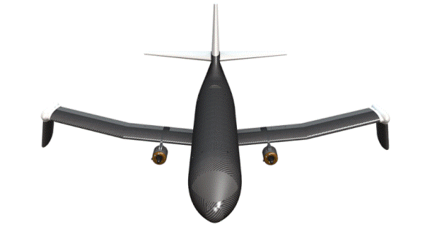
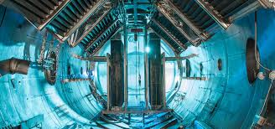
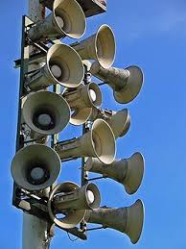
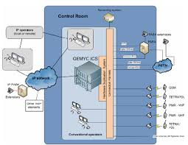
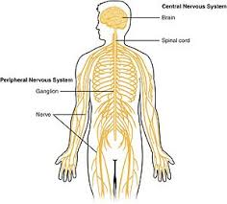
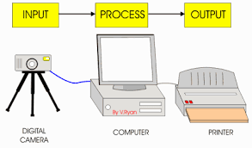

Slide 11
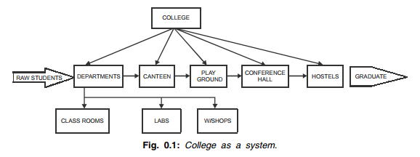
1.1 System Concept
It is very difficult to define system that covers all the aspects of the system.
A broader definition of a system is, “Any object which has some action to perform and is dependent on number of objects called entities, is a system”
Examples:

Slide 12

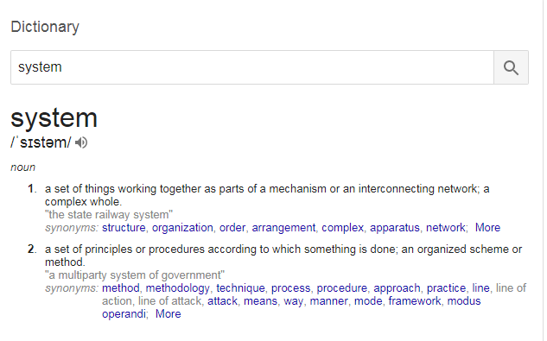
search

Slide 13
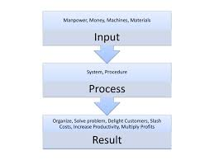
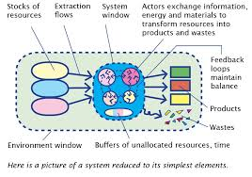
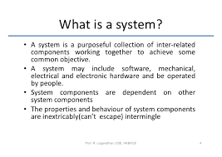
Google Images

Slide 14


video

Slide 15
System cont..
In other words-A set of detailed methods, procedures and routines created to carry out a specific activity, perform a duty, or solve a problem.
A system is defined as an aggregation or assemblage of objects joined in some regular interaction or interdependence to achieve system’s objectives.
Systems are of two types :-
• Static System
• Dynamic System
In static systems there are no changes over time where as in dynamic systems the interactions cause changes over time.

Slide 16
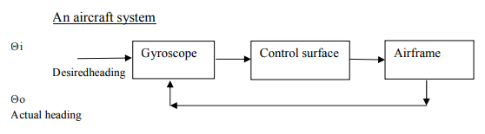
An Aircraft System

Slide 17
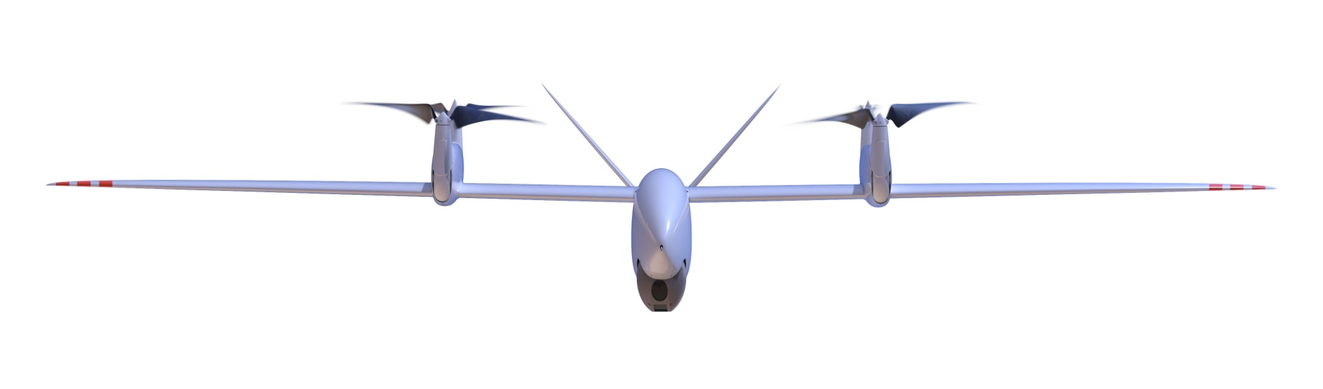
TRON

Slide 18
An Aircraft System cont...
Consider an aircraft flying under the control of an autopilot.
A gyroscope in the autopilot detects the difference between the actual heading and desired heading.
It sends a signal to move the control surfaces.
In response to the control surface movement the airframe steer towards the desired heading to the desired destination.

Slide 19
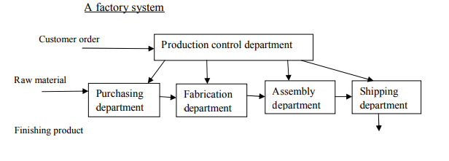
A factory System

Slide 20
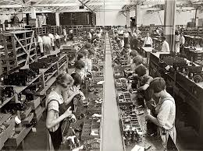
A factory System…
Consider a factory that make assembles parts for a product.
Two major components of the factory system are the fabrication department that makes the part & the assembly department that produces the product.
A purchasing department maintains & a shipping department dispatches the finished product.
A production control department receives order & assigns work to the other department.

Slide 21
Solar System-Assignment

Slide 22

Components of a system
Three basic components are:-
• Entity
• Attributes
• Activities
Entity: - It is used to denote an object of interest in a system.
Attribute: - It denotes a property of an entity.
Activity:-Any process that causes changes in the system is called as an activity.

Slide 23

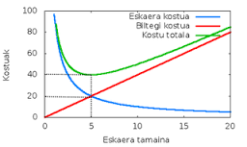
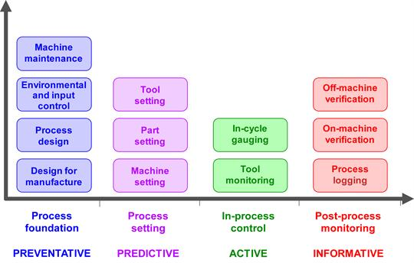
Components of a system cont..
Example:-
In the factory system the entities are the department, orders, parts and products.
Attributes are such factors as the quantities for each order, type of part or number of machines in a department.
The activities are the manufacturing process of the departments.

Slide 24
State of the system
State is used to mean a description of all the entities, attributes and activities as they exist at one point of time.
Progress:-The progress of the system is studied by the system following a change in the state of the system.

Slide 25
Class Assignment Name any three systems with entities, attributes and activities
System Name | Entities | Attributes | Activities
……………….. | ……. …… ….. | ……. …….. ……. | …… …….. ……..
System Name | Entities | Attributes | Activities
……………….. | ……. …… ….. | ……. …….. ……. | …… …….. ……..
System Name | Entities | Attributes | Activities
……………….. | ……. …… ….. | ……. …….. ……. | …… …….. ……..

Slide 26
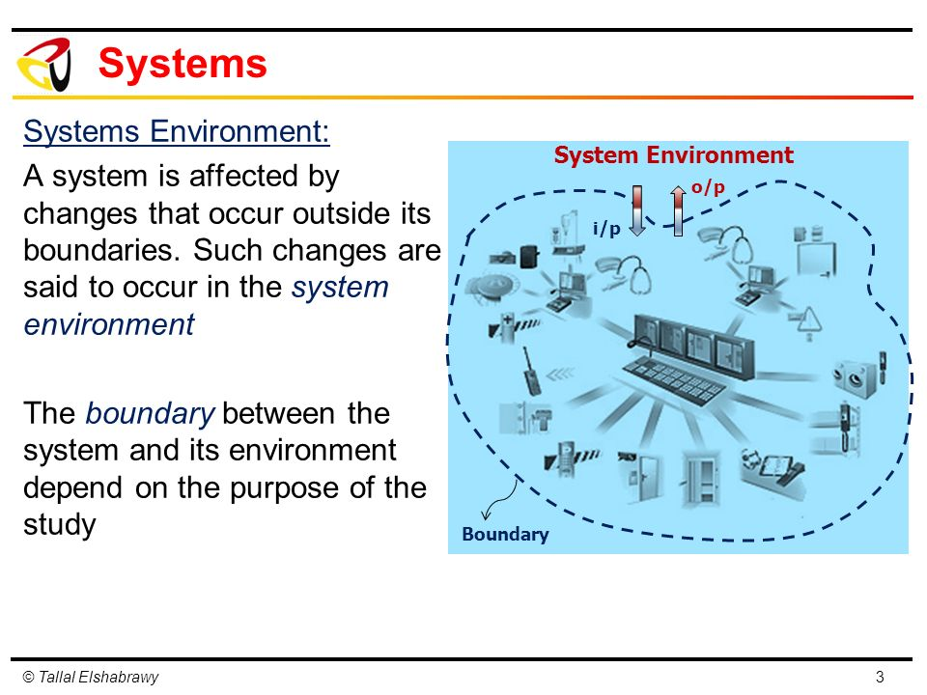
System Environment
A system is often affected by changes occurring outside the system.
Such changes occurring outside the system are said to occur in the system environment.
An important step in modeling system is to decide upon the boundary between the system and its environment.
The term endogenous is used to describe activities occurring within the system. Example: sports, cultural functions in a university system.
The term exogenous is used to describe the activities in the environment that affect the system. Example: strikes in a university system

Slide 27
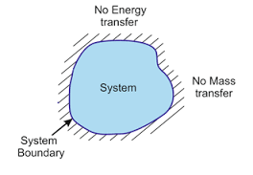
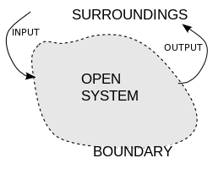
Open and Closed System
Based on these activities a system may be classified as open or closed system.
A system for which there is no exogenous activity is said to be a closed system.
A system that has exogenous activities is called as an open system.

Slide 28
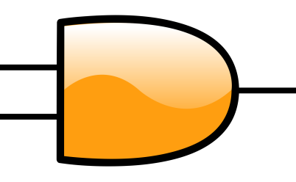
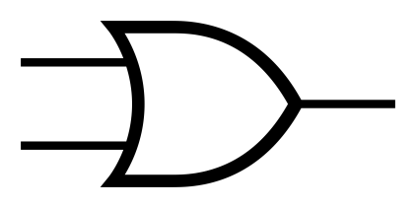


Deterministic vs.Stochastic Activities
Depending on the manner on which they can be described activities can be classified as
deterministic
stochastic.
Deterministic An activity is said to be deterministic where the outcome of an activity can be described completely in term of its input,
Example: AND, OR, NOT operations.
Stochastic An activity is said to be stochastic where the effects of the activity vary randomly over various possible outcomes.
Example: Throwing a dice or tossing a coin.

Slide 29
Continuous vs. Discrete system
Continuous system
Systems in which the changes are predominantly smooth are called continuous system.
Example: The movement of the aircraft occurs smoothly so aircraft system is a continuous system.
Discrete system
Systems in which the changes are predominantly discontinuous are called discrete system.
Example: Changes in the factory occur discontinuously so factory system is a discrete system.

Slide 30
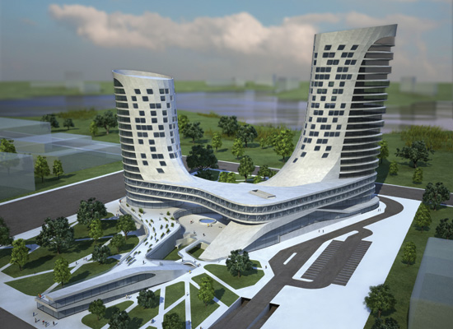
System Modeling
Model
The model is defined as the body of information about a system gathered for the purpose of studying the system.
The tasks of deriving a system model are divided into two subtasks. They are
1. Establishing the model structure
2. Supplying the data
Establishing the model structure :It determines the system boundary and identifies the entities, attributes and activities of the system.
Supplying the data :The data provides the values that the attributes can have and define the relationships involved in the activities.

Slide 31
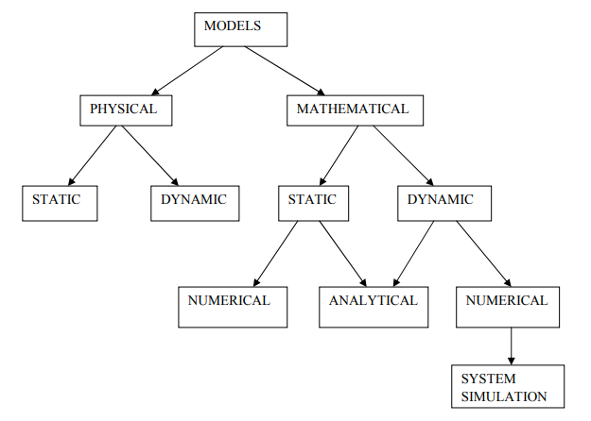
Types of Model

Slide 32
Types of Model..
Models are broadly classified into
1. physical models
2. mathematical models.
Physical models:
Physical models are based on some analogy between such systems as mechanical and electrical or electrical or hydraulic.
They deal with physical measurement such as length of wings, measurement of voltage, measurement of diameter of wheel and so on

Slide 33
Types of Model…
Mathematical models:
The mathematical model use symbolic notations and mathematical equations to represent a system.
The system attributes are represented by variables and the activities that represented by mathematical functions that interrelate the variables.
A second distinction is between static models and dynamic models.
Static models can only show the values that system attributes take where the system is in balanced.
Dynamic models follow the changes over time that result from system activities.

Slide 34
Types of Model..
In case of mathematical model the third distinction is a technique by which the model is solved that is actual values are assigned to system attributes.
A distinction is made between analytical and numerical method.
Applying analytical techniques means using the deductive reasoning of mathematical theory to solve a model.
Any assignment of numerical values that uses mathematical tables involves numerical method

Slide 35
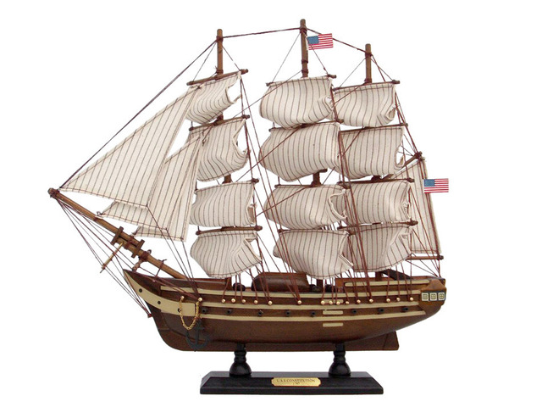
Types of Model..
Static physical models: They are used in ship buildings, modeling of DNA molecules, Wind Tunnels and designing air craft or ship.
Example: Scale models.

Slide 36
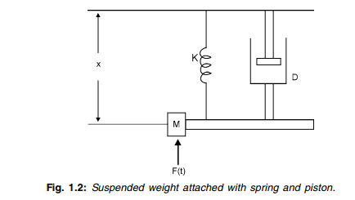
Types of Model..
Dynamic Physical models: They rely upon an analogy between the system being studied and some other system of a different nature.

Slide 37


Extension and contraction and shock absorber that absorbs the damping force proportional to the velocity of the mass. The motion of the system can be represented by the following differential equation.

Slide 38
Types of Model..
Where,
M = Mass
D = Damping factor of shock absorber
K = Stiffness constant of spring
x = Displacement of mass
F (t) = Applied force
The 2nd figure represents an electrical circuit with a resistance “R” and inductance “L” and capacitance “C” connected in series with a voltage source that varies in time according to the function E (t).
Let “q” be the charge on the capacitance. This system can be represented by the following equation-

Slide 39
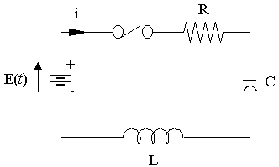
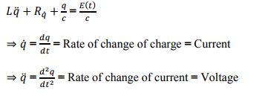
Types of Model..
Where,
L = Inductance
R = Resistance
q = Charge on Capacitance
C = Capacitance
E (t) = Function on voltage source that varies with time

Slide 40
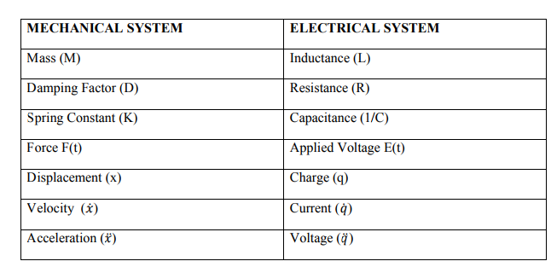
Types of Model..
By comparing two equation of mechanical system and electrical system which are similar to each other given below.

Slide 41
Types of Model..
Both the systems are analogues of each other and the performance of either can be studied with the other.
It is similar to modify the electrical system than to change the mechanical system.
Example: Two credit what effect a change in the shock absorber will have on the performance of the car.
It will only necessary to change value of resistance in the electrical circuit and observe the effect on the way the voltage varies.

Slide 42
Types of Model..
Static Mathematical Models: A static model gives the relationship between the system attributes when the system is in equilibrium.
Example: In marketing a commodity there is a balance between the supply and demand for the commodity. Both factor depend upon price.
The demand for a commodity will be low when the price is high and it will increase as the price drops.

Slide 43
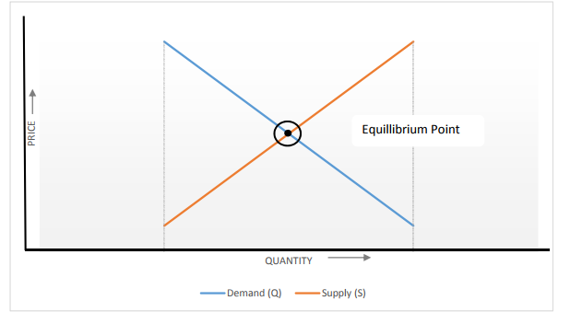
Types of Model..

Slide 44

Types of Model..
Demand is given by
Q = a - bp
Supply is given by
S = c + dp
At Stable point
S = Q (Equilibrium)
Where
Q = Demand
p = Price
S = Supply
a, b, c, d are constants.
At stable point
c + dp = a – bp=> (b + d) p = a – c
(Equilibrium price where demand = supply)

Slide 45
Assignment
Find the stable price when a=600, b=3000, c=-100 and d=2000.
Also find the supply and demand at that point.
Ans [0.14, 180]

Slide 46
Types of Model..
Dynamic Mathematical Model: It allows the changes of system attributes to be derived as a function of time. This derivation may be made with analytical solution or with a numerical computation depending upon the complexity of the model.
This an equation of a wheel suspension of a vehicle.

Slide 47
Types of Model..
A dynamic mathematical model allows the changes of system attributes to be derived as a function of time.
The derivation may be made with an analytical solution or with a numerical computation depending upon the with a numerical computation, depending upon the complexity of the model.
The equation that was derived to describe the behavior of a car wheel is an example of a dynamic mathematical model; in this case, an equation that can be solved analytically

Slide 48
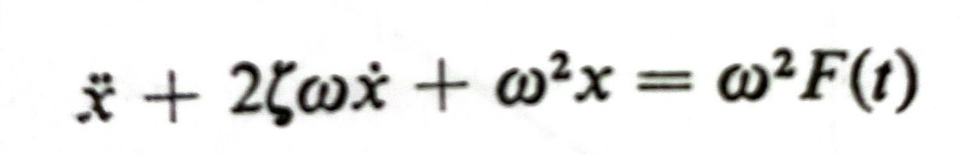
Types of Model..
It is customary to write the equation in the form
Where 2 ζ ω =D/M and ω 2=K/M
Expressed in this form, solutions can be given in terms of the variable ω t.
Figure below shows how x varies in response to a steady force applied at time t = 0 as would occur, for instance, if a load were suddenly placed on the automobile.
Solutions are shown for several values of ζ , and it can be seen that when ζ is less than 1, the motion is oscillatory

Slide 49
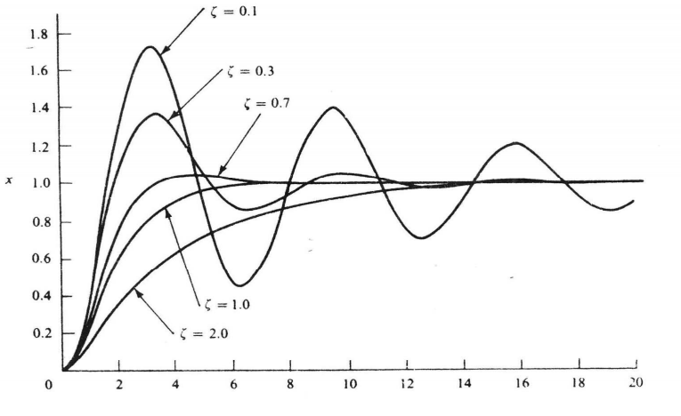
Types of Model..

Slide 50

Types of Model..
The factor ζ is called the damping ratio and, when the motion is oscillatory the frequency of oscillation is determined from the oscillatory, the frequency of oscillation is determined from the formula.
where f is the number of cycles per second.
Suppose a case is selected is representing a satisfactory frequency and damping. The relationship given above between ζ , ω ,M, k and D show how to select the spring and shock absorber to get that type of motion

Slide 51
Types of Model..
For example the condition for the motion to that type of motion. For example the condition for the motion to occur without oscillation requires that ζ ≥1.
It can be deduced from the definition of that the condition requires that D *D≥4MK.

Slide 52
Principles used in modeling [BARA]
The guiding principle of modeling are:
a. Block Building
b. Relevance
c. Accuracy
d. Aggregation

Slide 53
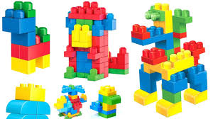
Principles used in modeling
a. Block Building:
The description of the system should be organized in a series of block.
The aim is to simplify the specification of the interaction with in a system.
Each block describes a part of the system that depends upon the few input variables and results in few output variables.
The system as a whole can be described in terms of interconnection between the blocks and can be represented graphically as a simple block diagram.
Example: The description of a factory is an example of a block diagram where each department has been treated as a separate block where the inputs and outputs being the work passed from department to department.

Slide 54
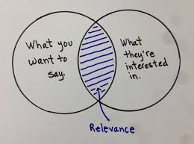

Principles used in modeling..
b. Relevance:
The model should only include those aspects of the system that are relevant to the study of the objective.
A relevant information should be excluded because it increases the complexity of the model and causes more work in solving the model.
c. Accuracy:
The accuracy of the information gathered for the model should be considered.

Slide 55
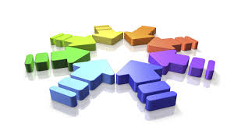
Principles used in modeling..
d. Aggregation:
It is the extent to which the number of individual entities can be grouped together into larger entities.
In some studies it may be necessary to construct artificial entities through the process of aggregation.
Example: An economic or social studies usually treats a population as a number of social classes and conduct the study as each social class as a distinct entity.

Slide 56
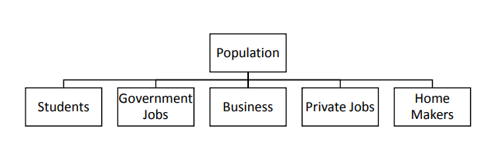
Principles used in modeling…

Slide 57
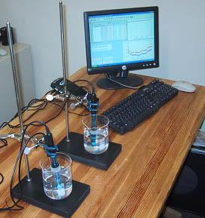
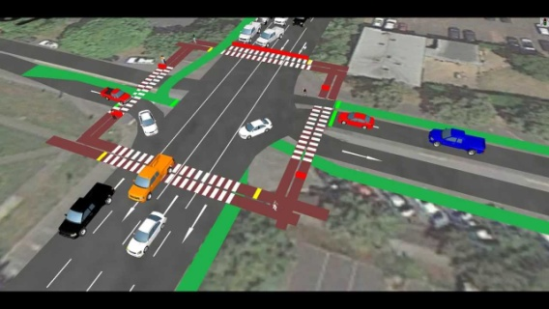
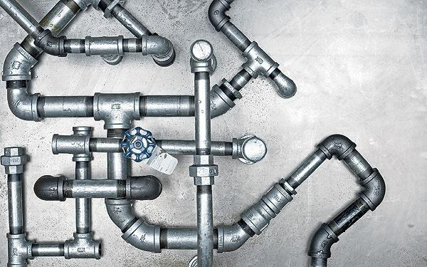
Application Areas of Simulation
Simulation is an experimental technique.
It is a fast and experimental method of doing an experiment under computer.
There is no specific unifying theory of computer simulation and no principle guiding the formulation of simulation model.
Simulation may be applied for system, there is difficult to predict like whether or public jam where the system itself is complex or the theory is not sufficiently regular.
Simulation provides an alternative that is cheap and fast and fills the gap between exact analysis and physical intuition.

Slide 58
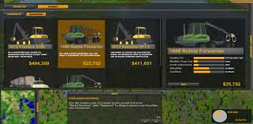
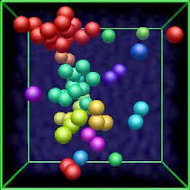

Application Areas of Simulation
Simulation in Science and Engineering Research:
Earlier most experiments were carried out physically in the laboratories. Millions were spent on physical models like network analyzers, Aircraft flight, Simulators and expensive experiments. Today a majority of experiments are simulated in a simulator. Computer experiments are faster cheaper, easier and provide better inside into the system than laboratory experiments.
Simulation in Soft science:
Simulation plays vital role in biology, sociology and economics, medicines etc., where experimenting could be very expensive dangerous or even impossible. In field such as Biology and economics, the problems are large involving thousands of variables and are complicated due to uncertainty.
Simulation for Business executive:
There are many problems faced by management that cannot be solved by standard operations research tools like linear and dynamic programming inventory and queuing. So a business executive has to make a decision best on his intuition and experiment. But with computer simulation he can make better and meaningful decisions. Simulation is widely used for inventory control, facility planning, production scheduling etc.

Slide 59
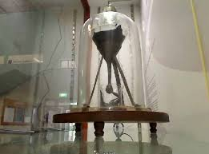

When to Simulate?
Experiments are too expensive, too dangerous, or the system to be investigated does not yet exist. These are the main difficulties of experimentation with real systems.
The time scale of the dynamics of the system is not compatible with that of the experimenter. For example, it takes millions of years to observe small changes in the development of the universe, whereas similar changes can be quickly observed in a computer simulation of the universe.
Variables may be inaccessible. In a simulation all variables can be studied and controlled, even those that are inaccessible in the real system.

Slide 60





When Simulation is not Appropriate
The problem is solvable by common sense.
The problem can be solved mathematically.
The direct experiments are easier.
The cost for simulation exceeds the saving.
The time for simulation is out of availability.
The input data are not available.
The simulation cannot be verified or validated.
The system behavior is too complex or unknown. e.g. modeling of human behavior.

Slide 61
Easy manipulation of models. Using simulation, it is easy to manipulate the parameters of a system model, even outside the feasible range of a particular physical system.

Slide 62
Verification and Validation of Model
Verification and validation of computer simulation models is conducted during the development of a simulation model with the ultimate goal of producing an accurate and credible model.
Simulation models are approximate imitations of real-world systems and they never exactly imitate the real-world system. Due to that, a model should be verified and validated to the degree needed for the models intended purpose or application

Slide 63

Verification
In the context of computer simulation, verification of a model is the process of confirming that it is correctly implemented with respect to the conceptual model (it matches specifications and assumptions deemed acceptable for the given purpose of application).
During verification the model is tested to find and fix errors in the implementation of the model
Various processes and techniques are used to assure the model matches specifications and assumptions with respect to the model concept.
The objective of model verification is to ensure that the implementation of the model is correct.

Slide 64
Verification
There are many techniques that can be utilized to verify a model. Including, but not limited to, have the model checked by an expert, making logic flow diagrams that include each logically possible action, examining the model output for reasonableness under a variety of settings of the input parameters, and using an interactive debugger.

Slide 65

Validation
Validation checks the accuracy of the model's representation of the real system.
Model validation is defined to mean "substantiation that a computerized model within its domain of applicability possesses a satisfactory range of accuracy consistent with the intended application of the model".
There are many approaches that can be used to validate a computer model.
The approaches range from subjective reviews to objective statistical tests. One approach that is commonly used is to have the model builders determine validity of the model through a series of tests

Slide 66
Validation
Naylor and Finger [1967] formulated a three-step approach to model validation that has been widely followed:
Step 1. Build a model that has high face validity.
Step 2. Validate model assumptions.
Step 3. Compare the model input-output transformations to corresponding input-output transformations for the real system.

Slide 67
Calibration
Calibration in measurement technology and metrology is the comparison of measurement values delivered by a device under test with those of a calibration standard of known accuracy.
Such a standard could be another measurement device of known accuracy, a device generating the quantity to be measured such as a voltage, or a physical artefact, such as a meter ruler.

Slide 68


Slide 69


Slide 70
Assignment 1
What is System? What are the basic component s of system? Explain with suitable example.
What is System Modeling? Explain with reference of supermarket model.
What is model? What are the types of model? Explain.
What are the principles used in modeling? Explain.
Name three or four on the principal entities, attribute and activities to be considered if you were to simulate the operation of
A gasoline filling
Cafeteria
Barber shop
College

Slide 71
In an automobile wheel suspension system, it is found that the shock absorber damping force is not strictly proportional to the velocity of the wheel. There is an additional force component equal to D2 times the acceleration of the wheel. Find the new condition for ensuring the wheel does not oscillate.
Derive the condition for non-oscillatory condition of automobile wheel. Assume necessary variables and condition as required.
In the aircraft system, suppose the control surface angle y is made to be A times the error signal. The response of the aircraft to the control surface is found to be I. Find the necessary conditions under which the aircraft motion is oscillatory. [Page no. 19, Qno. 1.6]

Slide 72
Suppose the automobile body in the suspension system example in not stationary. Consider the body to have a mass of M1 and assume that its motion is determined by the force of gravity and the reaction with the suspension system. Construct a model for the motions of the wheel and body.
Why is verification and validation required in simulation? Explain with suitable example.
What are the steps of validation? Explain

